Slide 1
Designing Readable Tactile Graphics

Slide 2
Virginia AER
Presented by
Lucia Hasty, MA
Braille Authority of North America
Tactile Graphics Committee Chair
March 3, 2010

Slide 3
Topics of Discussion
Why graphics are important
Quick look at tactile perception
Decision Tree: Is this a tactile
graphic?
Design principles
Planning a graphic
Editing the print graphic

Slide 4
LITERACY
Literacy is defined as
the ability to read and write
the ability to derive meaning from print material
The ability to communicate through written language

Slide 5
Graphics
are part of the set
of symbols that make
up written language

Slide 6
WHY IS IT IMPORTANT?
At least
50%
of text content
in today’s textbooks
is presented in graphic form.

Slide 7
High stakes tests
  State standards of learning
  College admission tests
  (ACT, SAT)

Slide 8
  Greater access to
  e-text and DAISY files

Slide 9
If braille readers are to be literate,
GRAPHICS SKILLS
must be developed.

Slide 10
Exploring
Tactual
Perception

Slide 11
Sighted Learners:
WHOLE TO PART
perceive all parts of an object
in its totality and
in its relationship to other objects.
Vision provides simultaneous perception.

Slide 12
Visually impaired learners:
PART TO WHOLE
rely on sequential observations.
only part of an object can be seen or felt at a time.
the entire image has to be "built-up" out of the components.
Relationships with other objects can be lost entirely.

Slide 13
REPRODUCE
REPRODUCE

Slide 14
REPRESENT

Slide 15
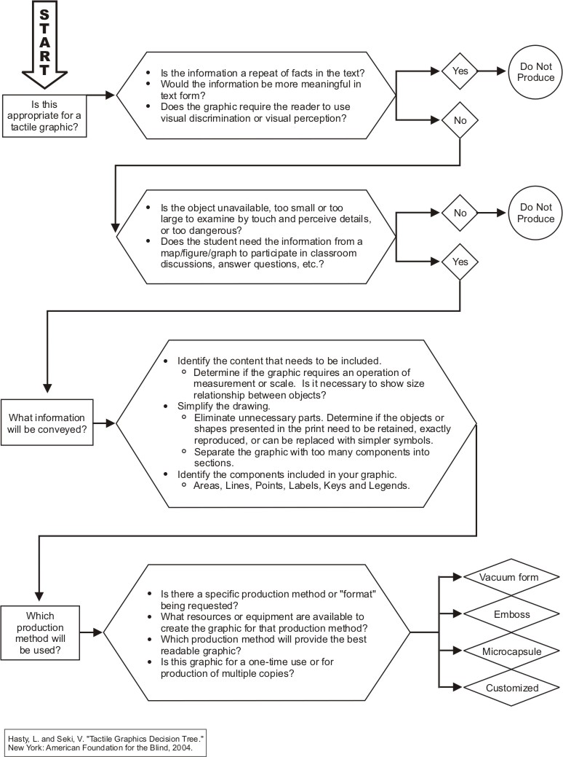

Slide 16
Is this appropriate for a tactile graphic?
Is the information a repeat of facts in the text?
Would the information be more meaningful in text form?
Does the graphic require the reader to use visual discrimination or visual perception??
Should this be a tactile graphic and a TN?

Slide 17
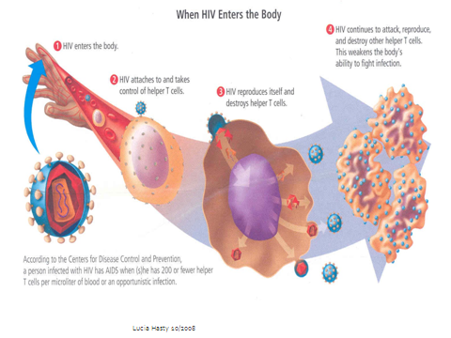

Slide 18
Guidelines for Describing
STEM Images
http://ncam.wgbh.org/
experience_learn/
educational_media/
stemdx

Slide 19
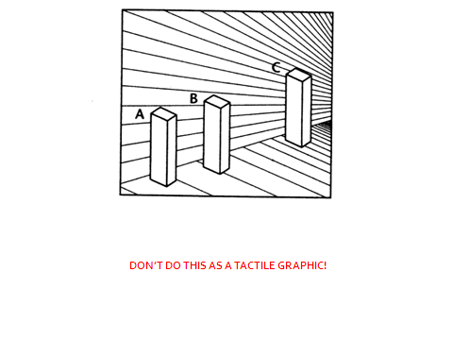

Slide 20
Planning and Editing
Identify the content to be included
Components of a graphic:
  Area
  Line
  Point Symbol
  Label
  Key or legend

Slide 21
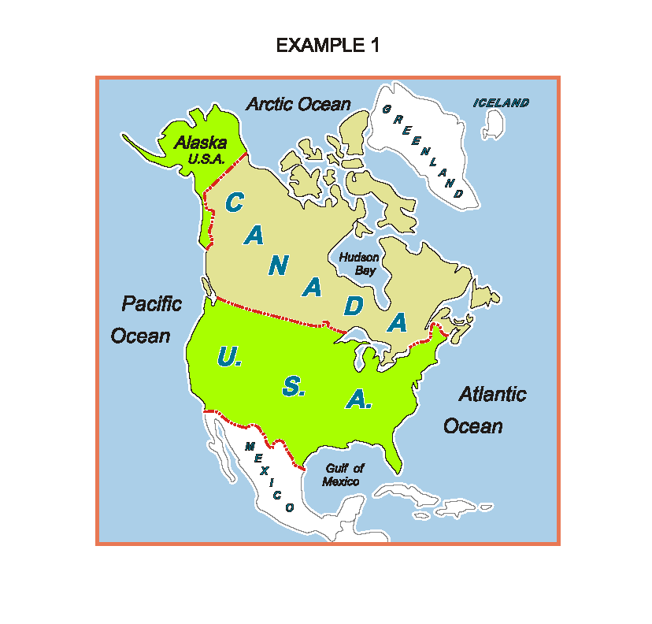

Slide 22
Simplify
1. Eliminate
    unnecessary parts (map scale, rivers if not needed as land marks)
    complicated shapes that can be replaced with simpler ones (instead of counting bicycles, substitute a basic shape- circle, triangle, square

Slide 23
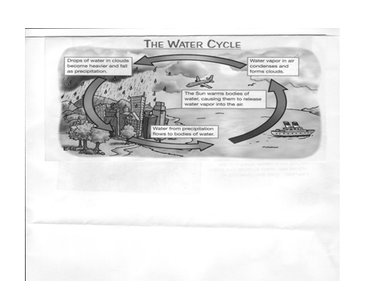

Slide 24
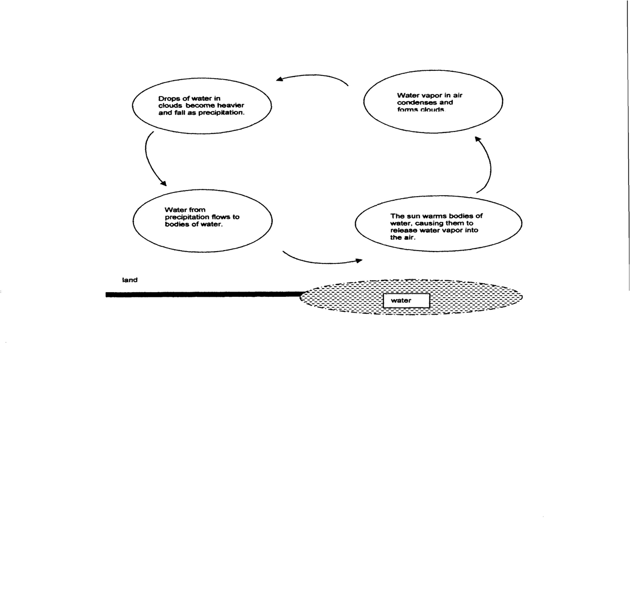

Slide 26
2. Consolidate
similar features (islands, exports)
areas of a range. Caution: must read text and any student activities to make sure the consolidation does not interfere with data student must identify or manipulate.

Slide 28
3. Distort if needed to provide tactile clarity (leaving additional space between a peninsula and mainland so that they can be seen as separate items)
4. Generalize outline shapes (smooth out shorelines)

Slide 29
5. Separate complex diagrams by
sections, categories, or layers
To put the separate parts back together into a whole picture, the reader needs
a thumbnail or overview diagram
a consistent point of reference on each section.

Slide 30
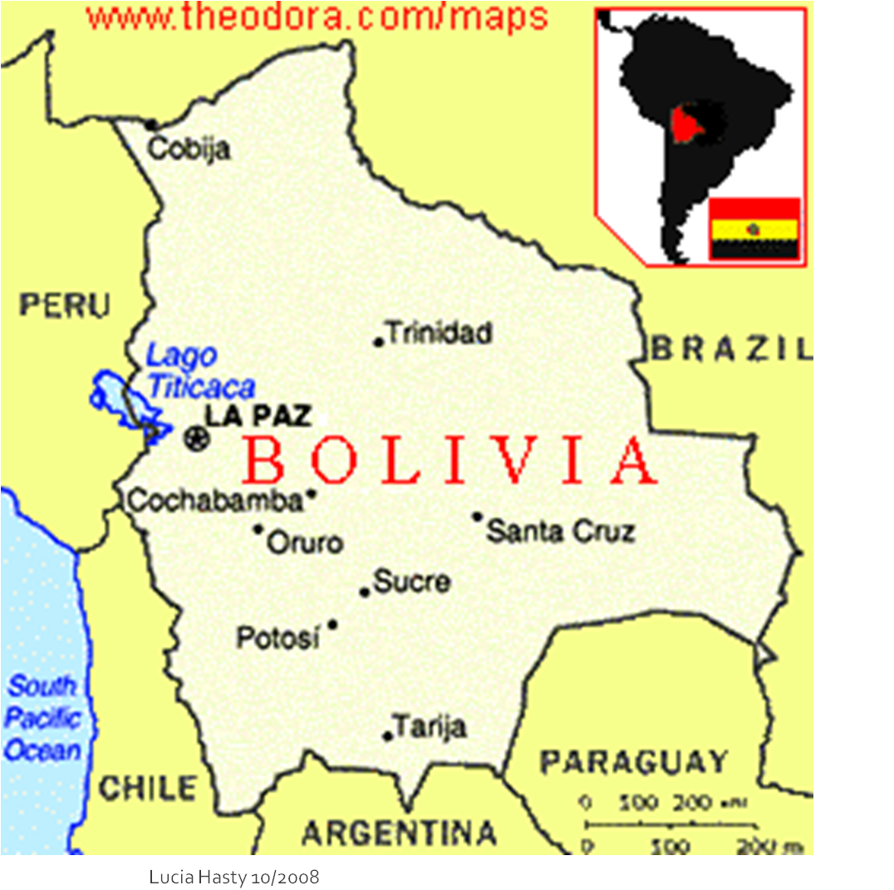

Slide 32
6. Change view from 3-D to 2-D if content allows. Show only a single side at a time.

Slide 35
7. Modify size, position, scale or layout if a clearer presentation can be made
8. Include some info in key instead of in diagram (e.g. capital city names)

Slide 36
CHARACTERISTICS OF A READABLE
TACTILE GRAPHIC
Movement = Texture = Tactile perception
Variety of heights
Contrast between areas
Simplicity
1/8 inch (absolute minimum) between line and label or point symbol. 1/4 inch may be required for clarity.

